Slide 1
머신러닝 (딥러닝)
Convolutional Neural Network (CNN)
컴퓨터AI공학부
2023년 2학기 컴퓨터공학과

Slide 2
CNN 개요
Convolution 연산
3D 데이터의 Convolution 연산

Slide 3
CNN 개요
Convolution 연산
3D 데이터의 Convolution 연산

Slide 4
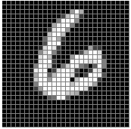
Convolutional Neural Networks - 개요
MLP 모델의 문제점
평탄화된 이미지를 입력으로 받아 공간적 (형상) 정보가 사라짐
CNN에 비해 필요한 weight parameter의 개수가 많음
평탄화
MLP
예측 결과
28 x 28
784 x 1
10 x 1
MLP의 입출력 구조 예시

Slide 5

Convolutional neural network (CNN)
Fully Connected (FC) Layer
FC Layer의 문제점
FC Layer는 1차원 데이터로 입력을 받음
따라서, 2D 이미지 데이터를 1D로 평탄화 해 입력함 ➔ 이미지의 공간적(형상) 정보가 무시됨
ex) 32x32x3 image -> stretch to 3072 x 1
input
activation
1
1
10 x 3072
weights
3072
10
Fei-Fei Li & Justin Johnson & Serena Yeung
출처: cs231n_2017_lecture5
April 18, 2017

Slide 6
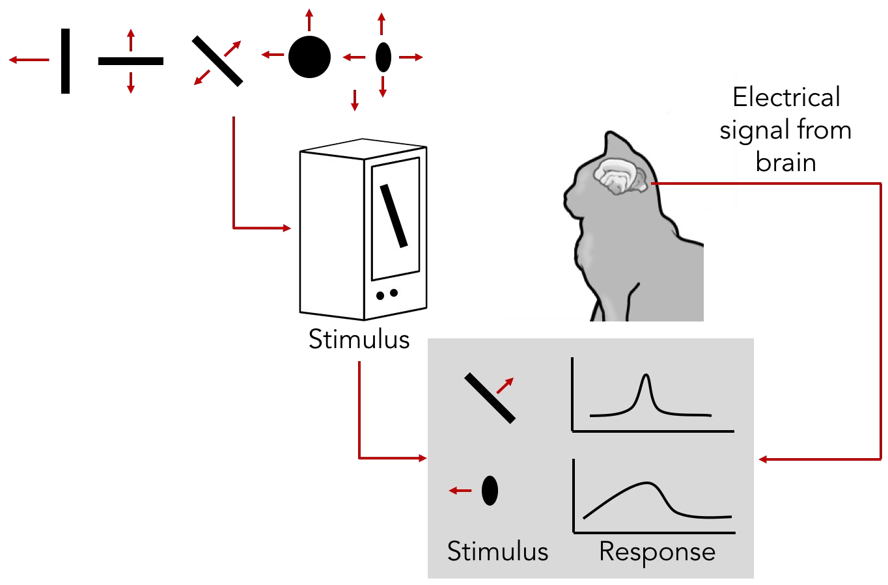
Convolutional neural network (CNN)
Overview
이미지의 특성에 따라 뉴런이 다르게 활성화 됨
Cat image by CNX OpenStax is licensed under CC BY 4.0; changes made

Slide 7
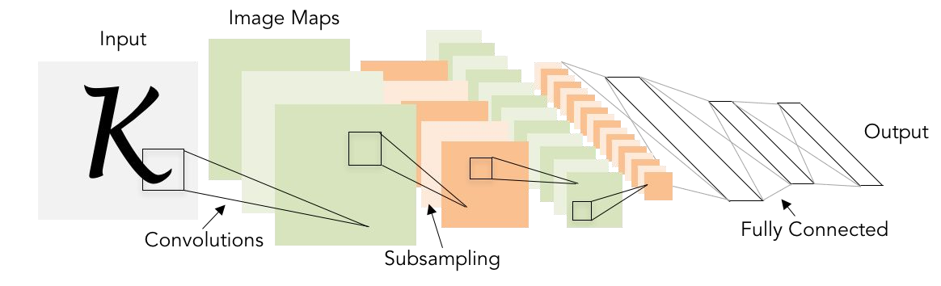
Convolutional neural network (CNN)
Overview
2D이미지를 Input으로 사용

Slide 8
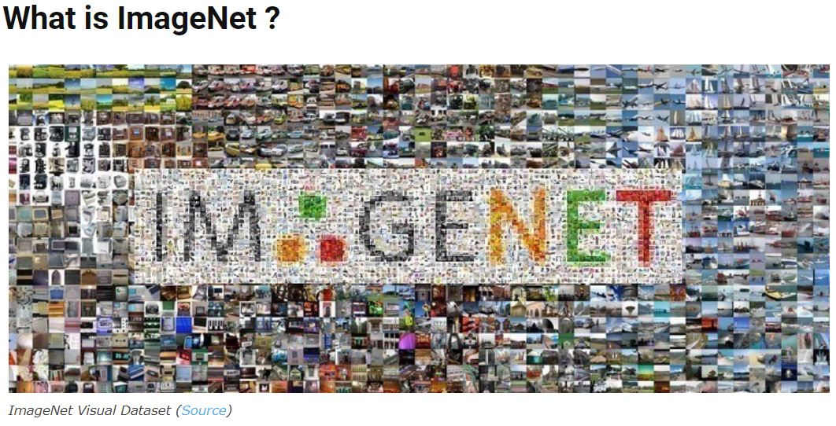
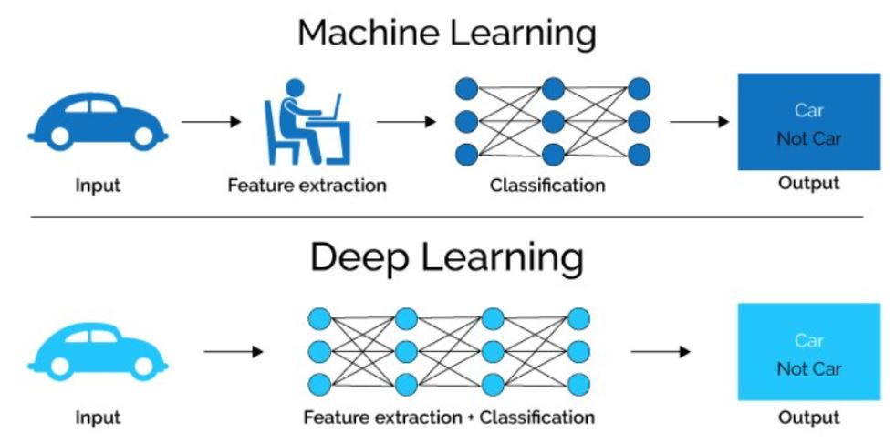

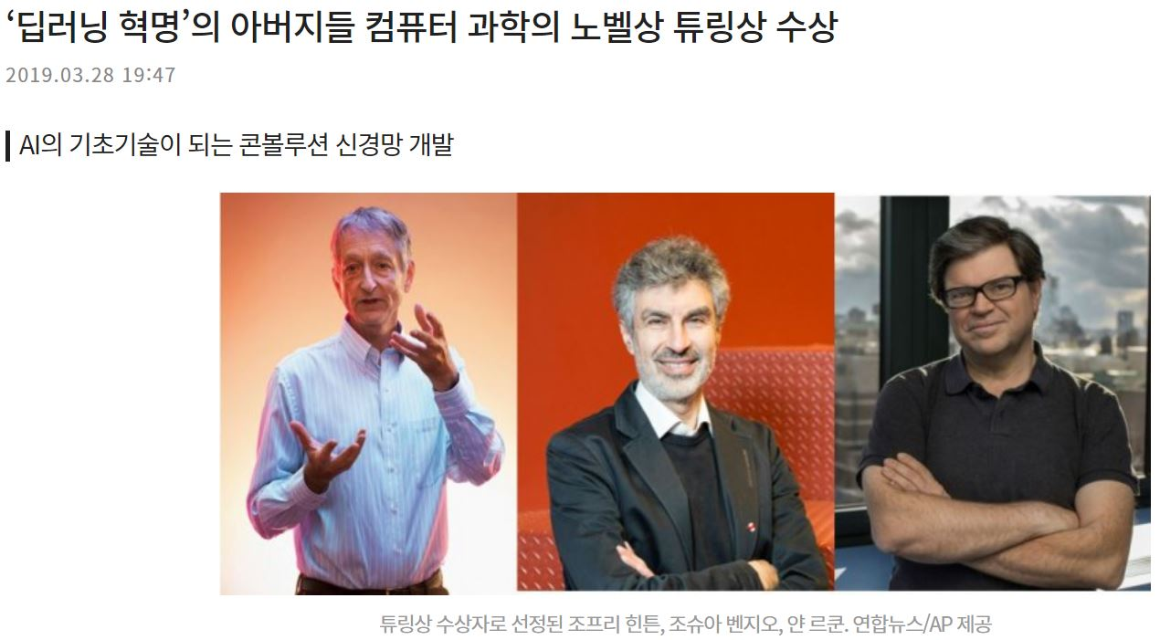
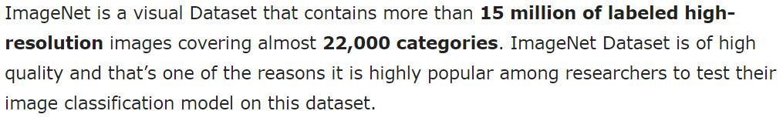
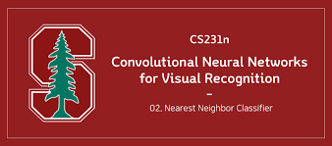
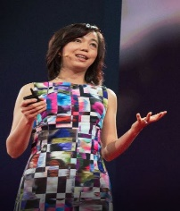


ImageNet Large Scale Visual Recognition Challenge (ILSVRC)

Slide 9


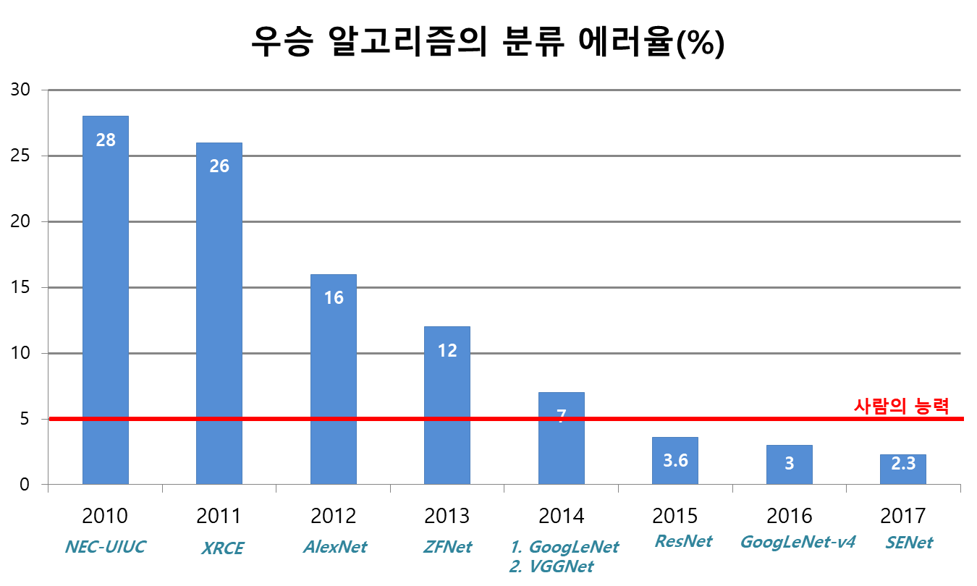
ImageNet Large Scale Visual Recognition Challenge (ILSVRC)

Slide 10
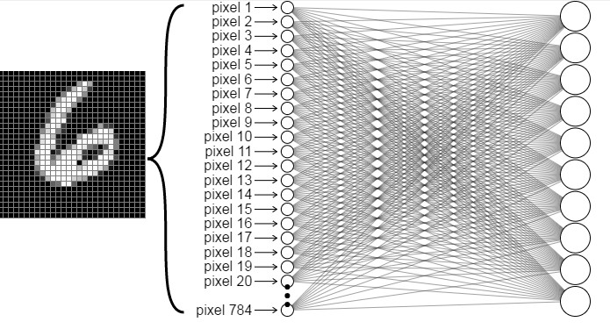
Convolutional Neural Networks - 개요
Perceptron 모델의 문제점
평탄화된 이미지를 입력으로 받아 공간적 (형상) 정보가 사라짐
CNN에 비해 필요한 weight parameter의 개수가 많음
28
32
28
32
[5x5x1]x64
64
784x10
Fully connected layer
(#weights: 7,840)
5x5 Convolution layer
(#weights: 1,600)

Slide 11
Convolutional Neural Networks - 개요
CNN 모델 개요
합성곱 연산 (Convolution)을 수행해 이미지의 특징 (Feature) 추출
이미지를 입력으로 받는 분야에서 높은 성능을 보임 (Ex. Image classification, Super-resolution, Denoising)
3x3x3 filters
filter 1
filter 2
32 (Height)
*
(Conv.)
30 (Height)
…
32 (Width)
30 (Width)
filter 32
3 (Channel)
32 (Channel)
Input image
Filter
(Kernel)
Feature maps

Slide 12


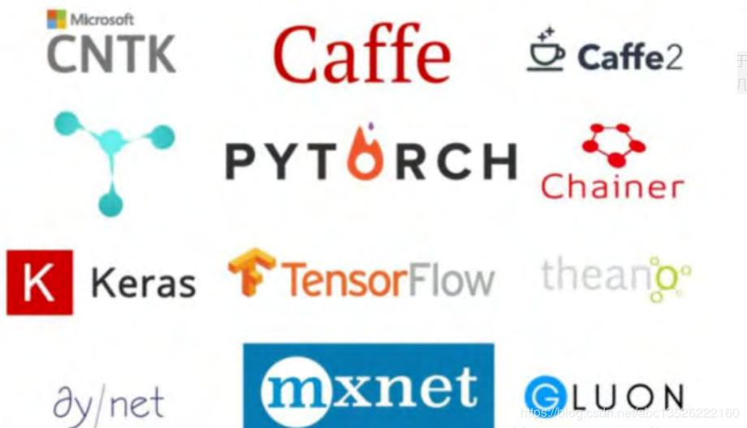


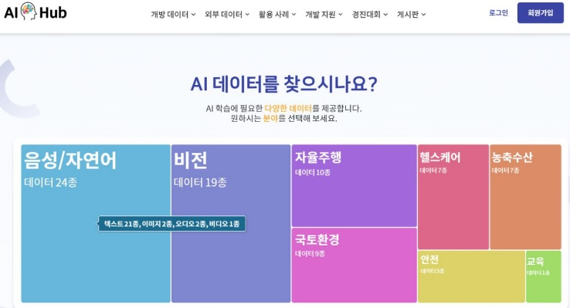
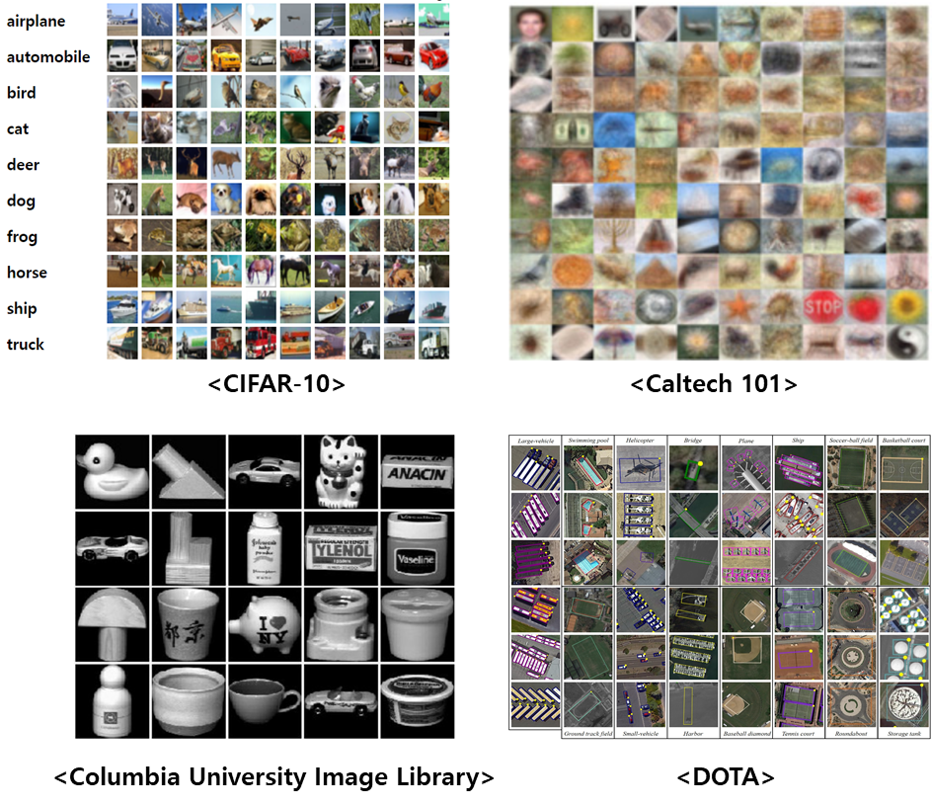
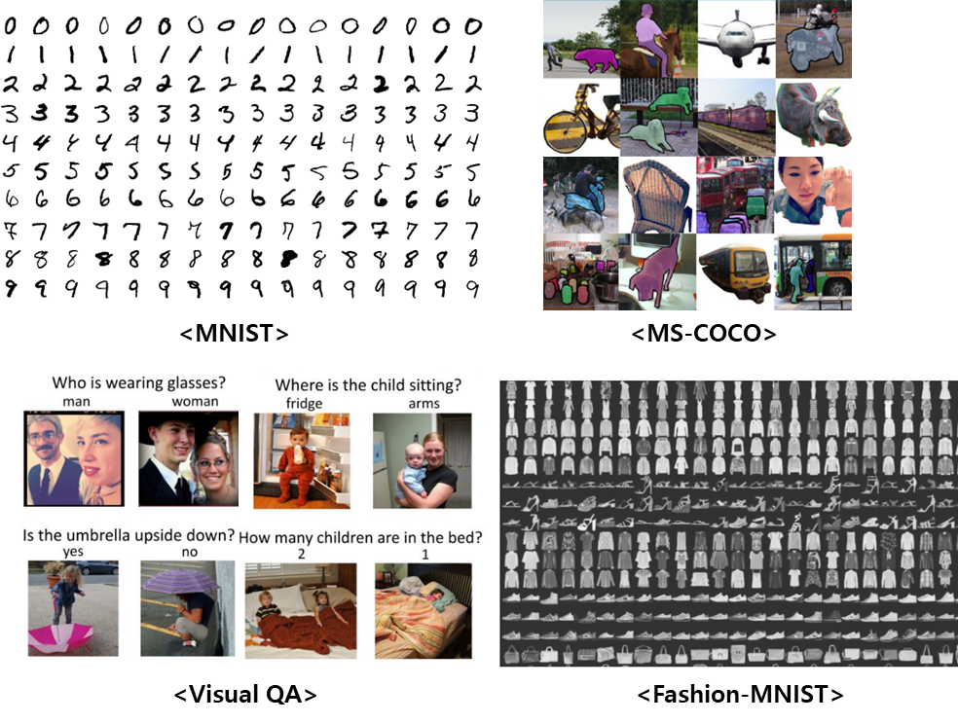
Democratization of AI
[AI 민주화] 누구나 AI로부터 차별 받지 않고 AI 기술에 쉽게 접근하고 개발할 수 있도록 하는 것!

Slide 13
CNN 개요
Convolution 연산
3D 데이터의 Convolution 연산

Slide 14
Convolutional Neural Networks - Convolution 연산
2D 이미지 입력에 대한 convolution 연산 예시
4x4x1 image
3x3x1 filter
Input image
Filter
(Kernel)

Slide 15
Convolutional Neural Networks - Convolution 연산
2D 이미지 입력에 대한 convolution 연산 예시
입력 이미지와 필터의 채널은 같아야 함
4x4x1 image
3x3x1 filter
Input image
Filter
(Kernel)

Slide 16
Convolutional Neural Networks - Convolution 연산
2D 이미지 입력에 대한 convolution 연산 예시
*
Conv.
연산
Input image
Filter (Kernel)
Output = 1x2 + 2x0 + 3x1 + 0x0 + 1x1 + 2x2 + 3x1 + 0x0 + 1x2
= 15
Input image

Slide 17
Convolutional Neural Networks - Convolution 연산
2D 이미지 입력에 대한 convolution 연산 예시
*
Conv.
연산
Input image
Filter (Kernel)
Input image
Input image
Input image
Input image

Slide 18
Convolutional Neural Networks - Convolution 연산
2D 이미지 입력에 대한 convolution 연산 예시
*
Conv.
연산
Input image
Filter (Kernel)

Slide 19
Convolutional Neural Networks - Convolution 연산
2D 이미지 입력에 대한 convolution 연산 예시
*
Conv.
연산
Input image
Filter (Kernel)
Output feature map

Slide 20

Convolutional Neural Networks - Convolution 연산
2D 이미지 입력에 대한 convolution 연산 예시
Output feature map
Input image

Slide 21
Convolutional Neural Networks - Convolution 연산
Stride: Convolution 연산의 step size
Stride가 커질수록 feature map의 크기는 작아짐
*
Stride=1
*
Output
feature map
Input image
Filter

Slide 22
Convolutional Neural Networks - Convolution 연산
Stride: Convolution 연산의 step size
Stride가 커질수록 feature map의 크기는 작아짐
*
*
Stride=1
Stride=2
*
*
Filter
Output
feature map
Output
feature map
Input image
Filter
Input image

Slide 23
Convolutional neural network (CNN)
Convolution Layer
Stride
Filter가 Convolution연산을 수행하는 Step size
7
7x7 input (spatially) assume 3x3 filter
7
Fei-Fei Li & Justin Johnson & Serena Yeung
출처: cs231n_2017_lecture5
April 18, 2017

Slide 24
Convolutional neural network (CNN)
Convolution Layer
Stride
Filter가 Convolution연산을 수행하는 Step size
7
7x7 input (spatially) assume 3x3 filter
7
Fei-Fei Li & Justin Johnson & Serena Yeung
출처: cs231n_2017_lecture5
April 18, 2017

Slide 25
Convolutional neural network (CNN)
Convolution Layer
Stride
Filter가 Convolution연산을 수행하는 Step size
7
7x7 input (spatially) assume 3x3 filter
7
Fei-Fei Li & Justin Johnson & Serena Yeung
출처: cs231n_2017_lecture5
April 18, 2017

Slide 26
Convolutional neural network (CNN)
Convolution Layer
Stride
Filter가 Convolution연산을 수행하는 Step size
7
7x7 input (spatially) assume 3x3 filter
7
Fei-Fei Li & Justin Johnson & Serena Yeung
출처: cs231n_2017_lecture5
April 18, 2017

Slide 27
Convolutional neural network (CNN)
Convolution Layer
Stride
Filter가 Convolution연산을 수행하는 Step size
7
5
7x7 input (spatially) assume 3x3 filter
=> 5x5 output
5
7
Fei-Fei Li & Justin Johnson & Serena Yeung
출처: cs231n_2017_lecture5
April 18, 2017

Slide 28
Convolutional neural network (CNN)
Convolution Layer
Stride
Filter가 Convolution연산을 수행하는 Step size
7
7x7 input (spatially) assume 3x3 filter applied with stride 2
7
Fei-Fei Li & Justin Johnson & Serena Yeung
출처: cs231n_2017_lecture5
April 18, 2017

Slide 29
Convolutional neural network (CNN)
Convolution Layer
Stride
Filter가 Convolution연산을 수행하는 Step size
7
7x7 input (spatially) assume 3x3 filter applied with stride 2
7
Fei-Fei Li & Justin Johnson & Serena Yeung
출처: cs231n_2017_lecture5
April 18, 2017

Slide 30
Convolutional neural network (CNN)
Convolution Layer
Stride
Filter가 Convolution연산을 수행하는 Step size
7
7x7 input (spatially) assume 3x3 filter applied with stride 2
=> 3x3 output!
3
3
7
Fei-Fei Li & Justin Johnson & Serena Yeung
출처: cs231n_2017_lecture5
April 18, 2017

Slide 31
Convolutional Neural Networks - Convolution 연산
Padding: Input image 주변 값을 특정 값 (주로 0) 으로 채워 줌
Convolution 연산으로 boundary 정보가 소실되는 문제를 방지
*
Padding size = 0
stride: 1
Output
feature map
Input image
Filter

Slide 32
Convolutional Neural Networks - Convolution 연산
Padding: Input image 주변 값을 특정 값 (주로 0) 으로 채워 줌
Convolution 연산으로 boundary 정보가 소실되는 문제를 방지
*
Padding size = 0
stride: 1
Output
feature map
Input image
Filter
*
Padding size = 1
stride: 1
Output
feature map
Input image
Filter

Slide 33
Convolutional neural network (CNN)
Convolution Layer
Padding
Input data의 주변을 특정 값으로 채움 (보통 0을 사용)
Convolution 연산으로 boundary의 정보가 소실되는 문제점을 방지

Slide 34
Convolutional Neural Networks - Convolution 연산
Convolution 연산의 출력 크기 계산
출력 크기는 filter size, stride, padding size에 따라 달라짐
출력 크기는 정수로 나누어 떨어져야 함
(H, W): Input data size
(FW, FH): Filter size
P: Padding size
S: Stride

Slide 35
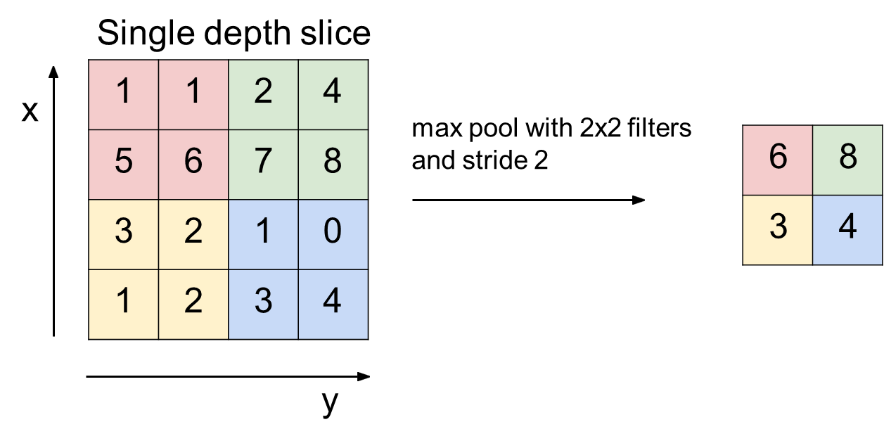

Convolutional Neural Networks - Convolution 연산
Pooling: Input data의 dimension을 subsampling 하는 방법
2x2 max pooling 예시
2x2 average pooling 예시

Slide 36
CNN 개요
Convolution 연산
3D 데이터의 Convolution 연산

Slide 37
Convolutional Neural Networks - 3D 데이터의 Convolution 연산
3D 이미지 (RGB) 입력에 대한 2D convolution 연산
입력 이미지와 필터의 채널은 같아야 함
4x4x3
3x3x3
2x2x1
*
Filter
(Kernel)
Output
feature map
Input image
(Input feature map)

Slide 38
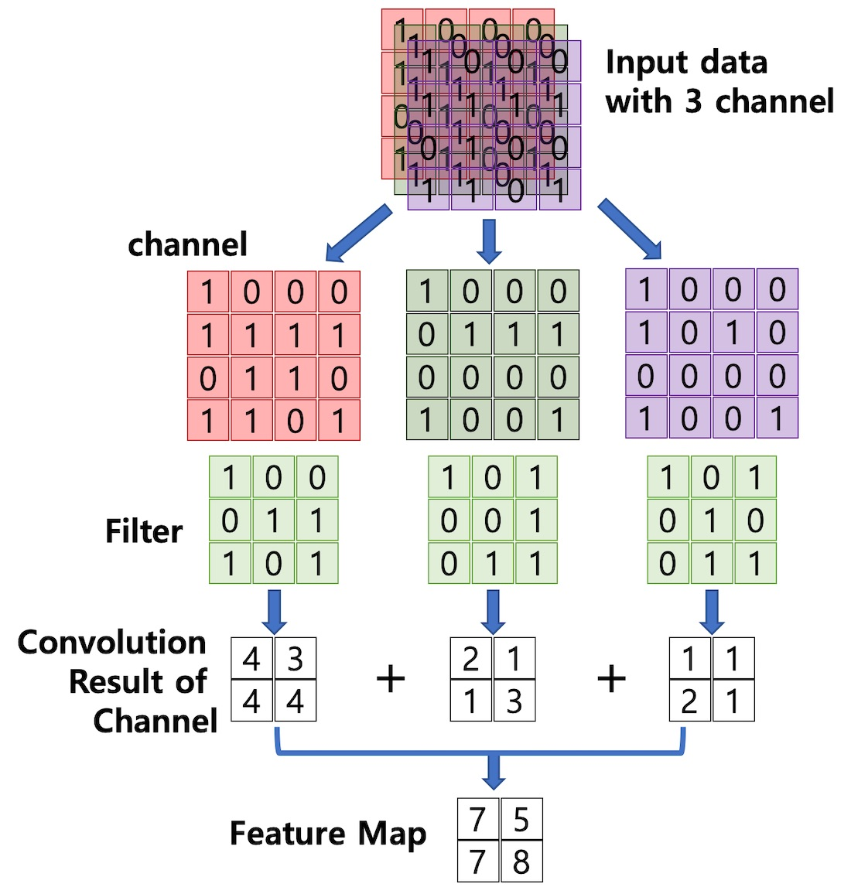
Convolutional Neural Networks - 3D 데이터의 Convolution 연산
3D 이미지 (RGB) 입력에 대한 2D convolution 연산
4x4x3
3x3x3
2x2x1
*
Input image
Filter
(Kernel)
Output
feature map

Slide 39
Convolutional Neural Networks - 3D 데이터의 Convolution 연산
4x4x3
(Input)
3x3x3 (Filter)
(1)

Slide 40
Convolutional Neural Networks - 3D 데이터의 Convolution 연산
4x4x3
(Input)
3x3x3 (Filter)
(1)
(2)

Slide 41
Convolutional Neural Networks - 3D 데이터의 Convolution 연산
4x4x3
(Input)
3x3x3 (Filter)
(1)
(2)
2x2x1
Output
feature map
(3)
(4)

Slide 42
Convolutional Neural Networks - 3D 데이터의 Convolution 연산
3D 이미지 (RGB) 입력에 대한 2D convolution 연산
(1)
*

Slide 43
Convolutional Neural Networks - 3D 데이터의 Convolution 연산
3D 이미지 (RGB) 입력에 대한 2D convolution 연산
(1)
(2)
*
*

Slide 44
Convolutional Neural Networks - 3D 데이터의 Convolution 연산
3D 이미지 (RGB) 입력에 대한 2D convolution 연산
(1)
(2)
*
*
(3)
(4)
*
*
Output
feature map

Slide 45
Convolutional Neural Networks - 3D 데이터의 Convolution 연산
3D 이미지 (RGB) 입력에 대한 2D convolution 연산
Output feature map의 채널 수는 filter의 개수(N)와 같음
3x3x3 filters
4x4x3
filter 1
2x2x1
2x2x1
2x2xN
*
…
…
filter N
#filters (N)
Input image
Filter
(Kernel)
Output
feature map

Slide 46
Convolutional neural network (CNN)
Convolution Layer
Overview
32x32x3 image -> preserve spatial structure
32
height
32
depth
width
3
Fei-Fei Li & Justin Johnson & Serena Yeung
출처: cs231n_2017_lecture5
April 18, 2017

Slide 47
Convolutional neural network (CNN)
Convolution Layer
Overview
32x32x3 image -> preserve spatial structure
height
5x5x3 filter
32
32
depth
width
3
Fei-Fei Li & Justin Johnson & Serena Yeung
출처: cs231n_2017_lecture5
April 18, 2017

Slide 48
Convolutional neural network (CNN)
Convolution Layer
Overview
Filters always extend the full depth of the input volume
32x32x3 image
height
5x5x3 filter
32
32
depth
width
3
Fei-Fei Li & Justin Johnson & Serena Yeung
출처: cs231n_2017_lecture5
April 18, 2017

Slide 49
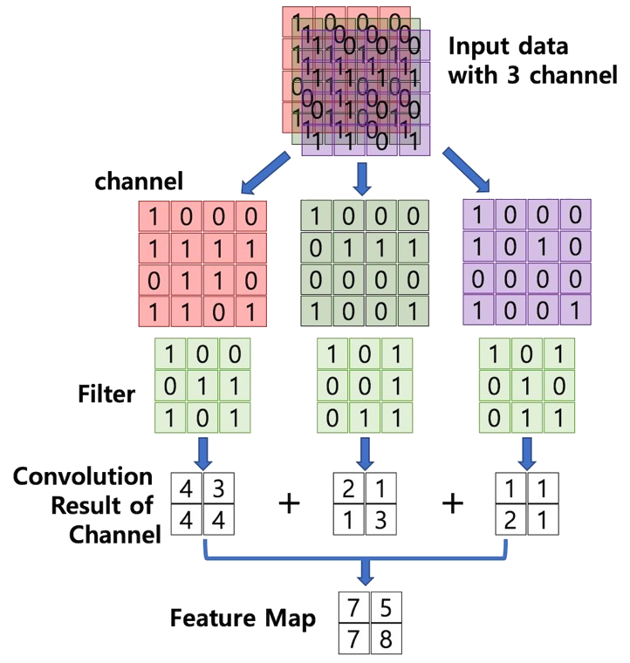
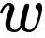
Convolutional neural network (CNN)
Convolution Layer
Overview
32x32x3 image 5x5x3 filter
Wx+b
32
32
3
Fei-Fei Li & Justin Johnson & Serena Yeung
출처: cs231n_2017_lecture5
April 18, 2017

Slide 50
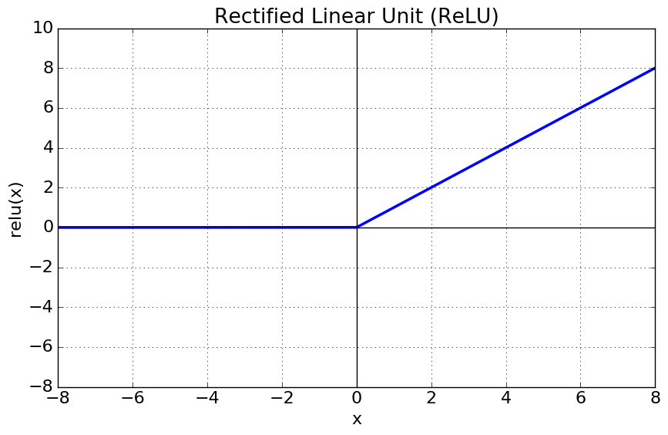
Convolutional neural network (CNN)
Convolution Layer
Overview
32x32x3 image 5x5x3 filter
Wx+b ➔ ReLU(Wx+b)
➔ One number!
32
32
3
Fei-Fei Li & Justin Johnson & Serena Yeung
출처: cs231n_2017_lecture5
April 18, 2017

Slide 51
Convolutional neural network (CNN)
Convolution Layer
Overview
One number = ReLU(Wx+b)
32
32
3
Fei-Fei Li & Justin Johnson & Serena Yeung
출처: cs231n_2017_lecture5
April 18, 2017

Slide 52
Convolutional neural network (CNN)
Convolution Layer
Overview
One number = ReLU(Wx+b)
32
32
3
Fei-Fei Li & Justin Johnson & Serena Yeung
출처: cs231n_2017_lecture5
April 18, 2017

Slide 53
Convolutional neural network (CNN)
Convolution Layer
Overview
32
One number = ReLU(Wx+b)
32
3
Fei-Fei Li & Justin Johnson & Serena Yeung
출처: cs231n_2017_lecture5
April 18, 2017

Slide 54
Convolutional neural network (CNN)
Convolution Layer
Overview
32
One number = ReLU(Wx+b)
32
3
Fei-Fei Li & Justin Johnson & Serena Yeung
출처: cs231n_2017_lecture5
April 18, 2017

Slide 55
Convolutional neural network (CNN)
Convolution Layer
Overview
activation map
32
28
convolve (slide) over all spatial locations
32
28
3
1
Fei-Fei Li & Justin Johnson & Serena Yeung
출처: cs231n_2017_lecture5
April 18, 2017

Slide 56
Convolutional neural network (CNN)
Convolution Layer
Overview
Consider a second, green filter
32x32x3 image 5x5x3 filter
activation maps
32
28
convolve (slide) over all spatial locations
32
28
3
1
Fei-Fei Li & Justin Johnson & Serena Yeung
출처: cs231n_2017_lecture5
April 18, 2017

Slide 57
Convolutional neural network (CNN)
Convolution Layer
Overview
For example, if we had 6 5x5x3 filters, we`ll get 6 separate activation maps
activation maps
32
28
Convolution Layer
32
28
3
6
Fei-Fei Li & Justin Johnson & Serena Yeung
출처: cs231n_2017_lecture5
April 18, 2017

Slide 58
Convolutional neural network (CNN)
Convolution Layer
Overview
ConvNet is a sequence of Convolutional Layers, interspersed with activation functions
32
28
24
….
CONV, ReLU
e.g. 6 5x5x3 filters
CONV, ReLU
e.g. 10 5x5x6
filters
CONV, ReLU
32
28
24
3
6
10
Fei-Fei Li & Justin Johnson & Serena Yeung
출처: cs231n_2017_lecture5
April 18, 2017

Slide 59
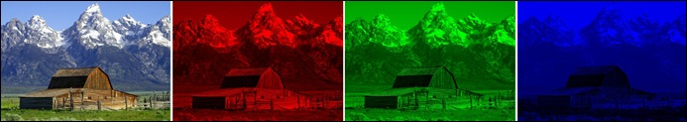
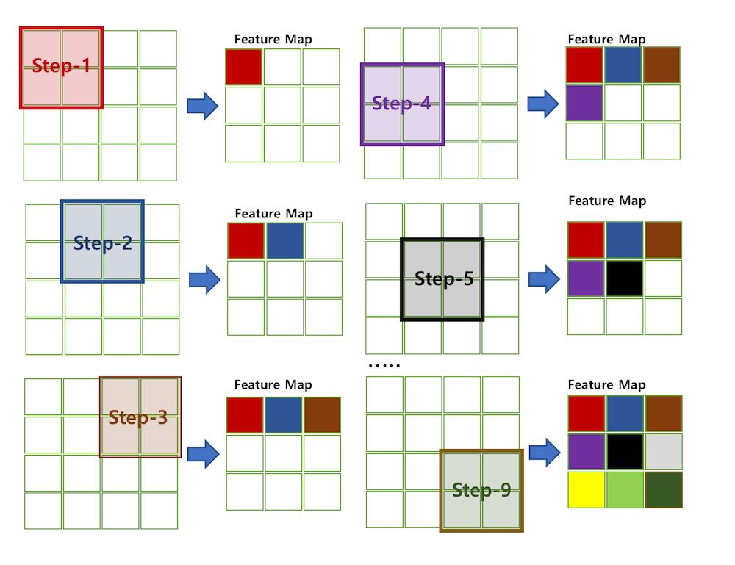


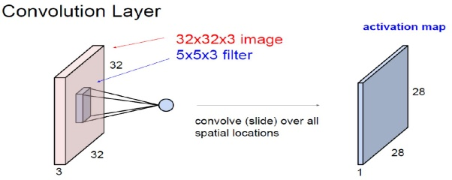
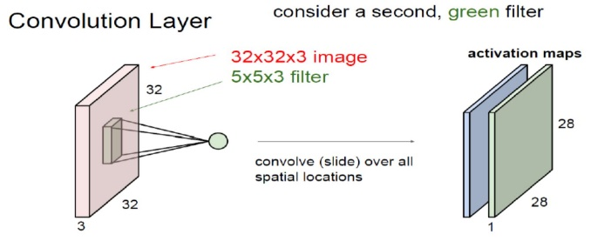
Convolutional Operation
Convolution

Slide 60
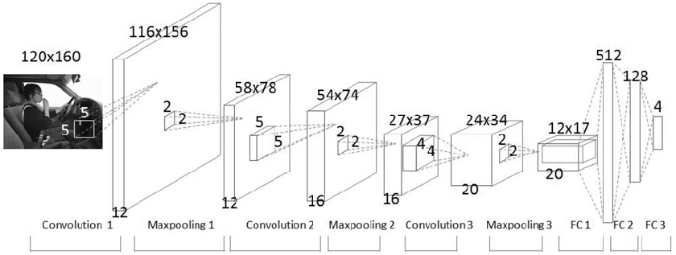
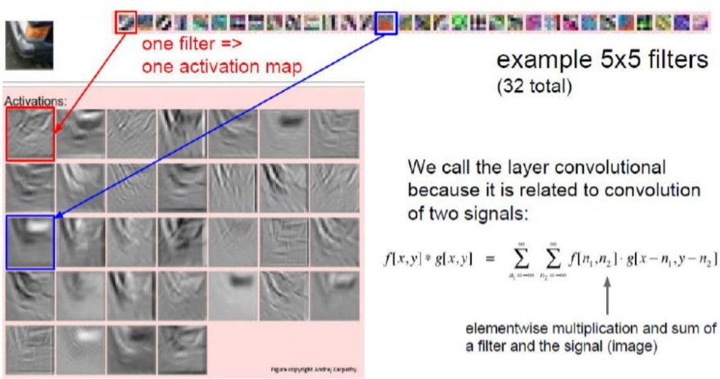
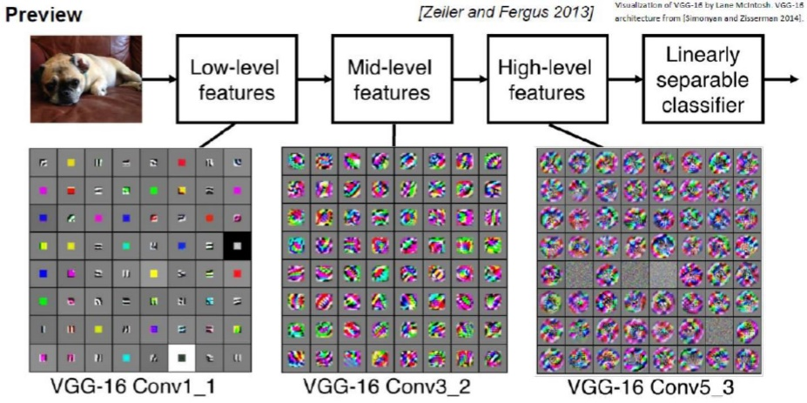
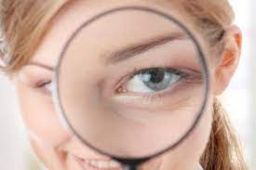

Deep Learning: CNN Visualization
Example of graphical CNN representation
CNN trains the multiple filters (Kernel).

Slide 61

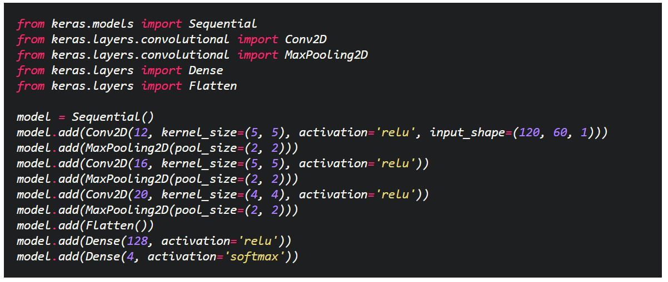
CNN Implementation

Slide 62
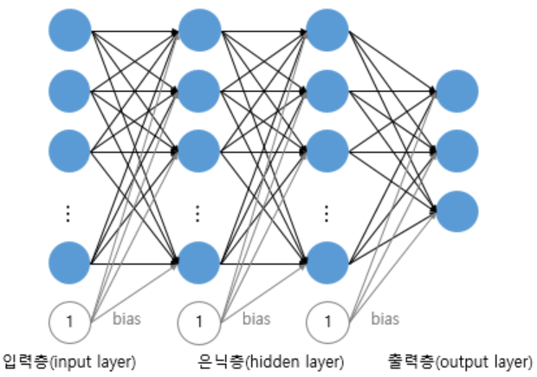
Convolutional Neural Network (CNN) 이론
CNN을 이용한 classification model 설계 시 주의사항
Output node의 값이 숫자 예측 확률을 나타냄
10x1
784x1
MLP model 예시

Slide 63
Convolutional Neural Network (CNN) 이론
CNN을 이용한 classification model 설계 시 주의사항
28x28x1
24x24x32
20x20x32
…
Conv. 1
[5x5x1]x32
Conv. 2
[5x5x32]x32
출력의 형태가 cube 이므로
예측 확률을 확인 할 수 없음
CNN model 예시

Slide 64
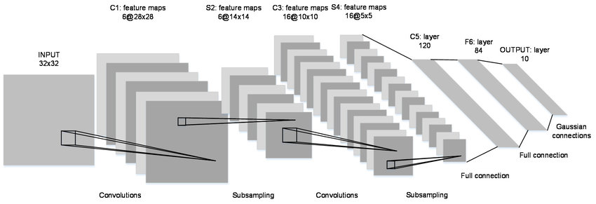
Convolutional Neural Network (CNN) 이론
CNN을 이용한 classification model 설계 시 주의사항
일반적으로 CNN의 feature map을 평탄화 한 이후 fully connected layer에 입력함
FC3
FC2
평탄화 & FC1
Convolution 1
Pooling
Convolution 2
Pooling
LeNet-5 구조
Ref.: [Proc. on IEEE 1998] Gradient-based learning applied to document recognition

Slide 65
LeNet-5 구조
C1
S2
S4
C5
F6
Ref.: [Proc. on IEEE 1998] Gradient-based learning applied to document recognition

Slide 66
Applications
Ref.: [Proc. on IEEE 1998] Gradient-based learning applied to document recognition

Slide 67
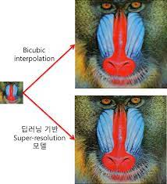
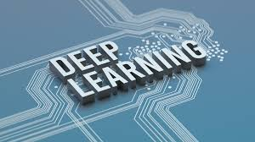
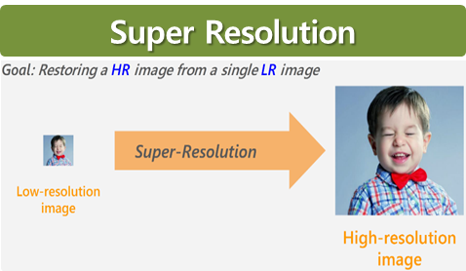
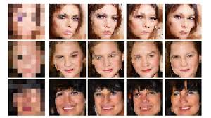
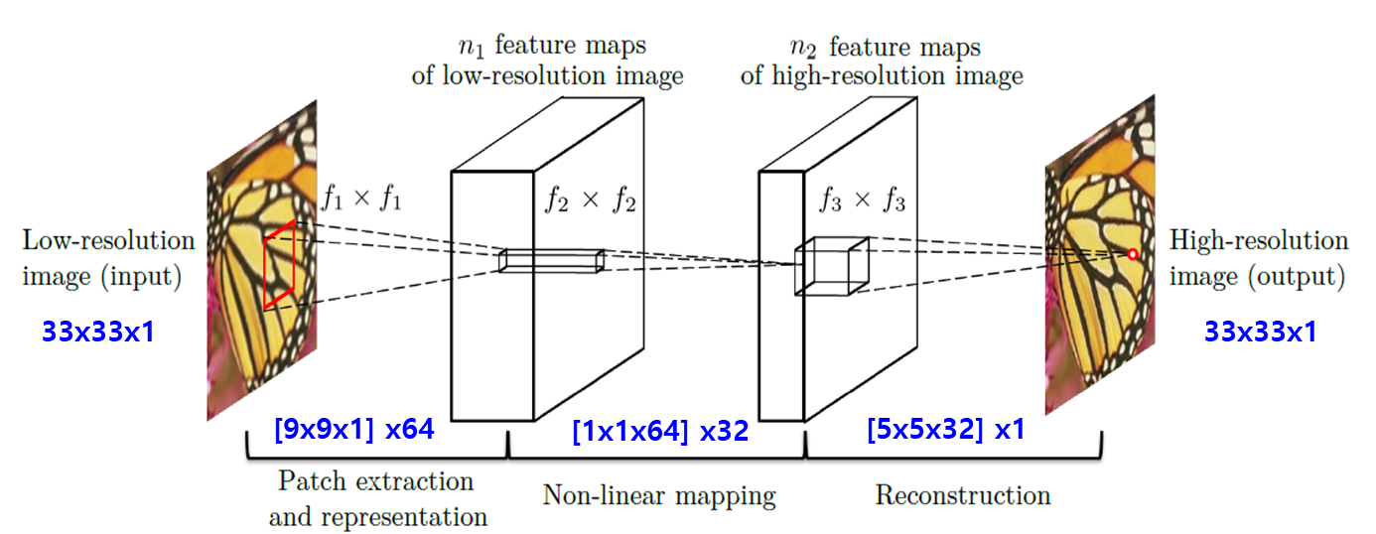
Applications
CNN based Super Resolution (SR)
* Reference: IEEE Trans. PAMI “Image Super-Resolution Using Deep Convolutional Networks” Chao Dong et.al, 2015

Slide 68

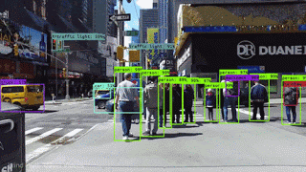
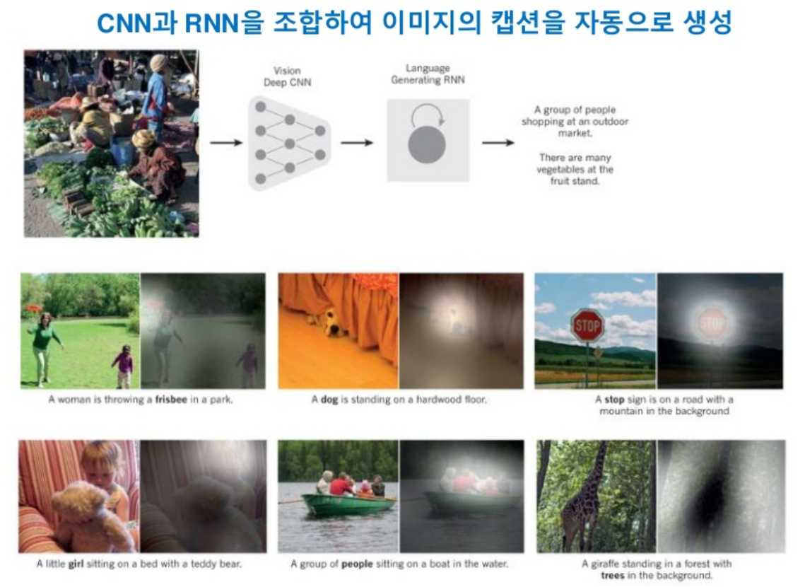
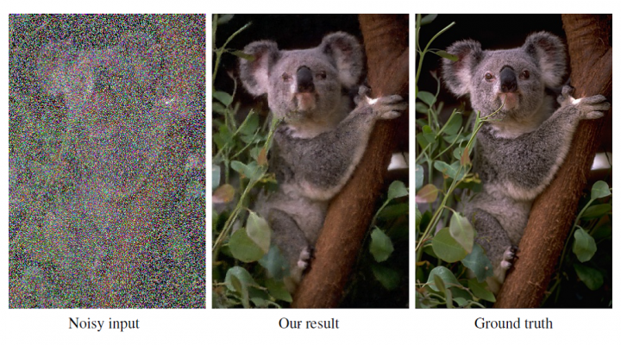
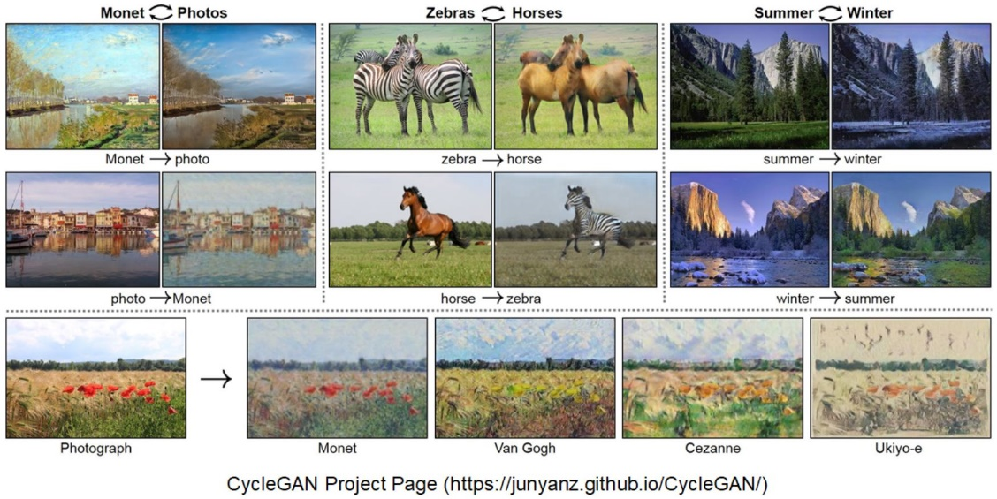
Applications
Paradigm Shift (Image/Video Processing)

Slide 69
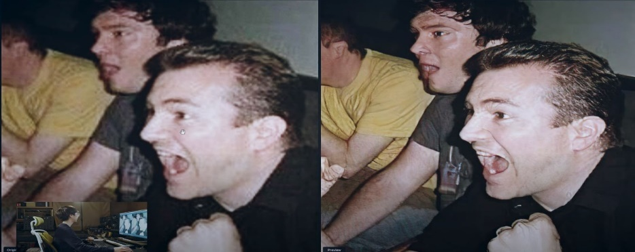
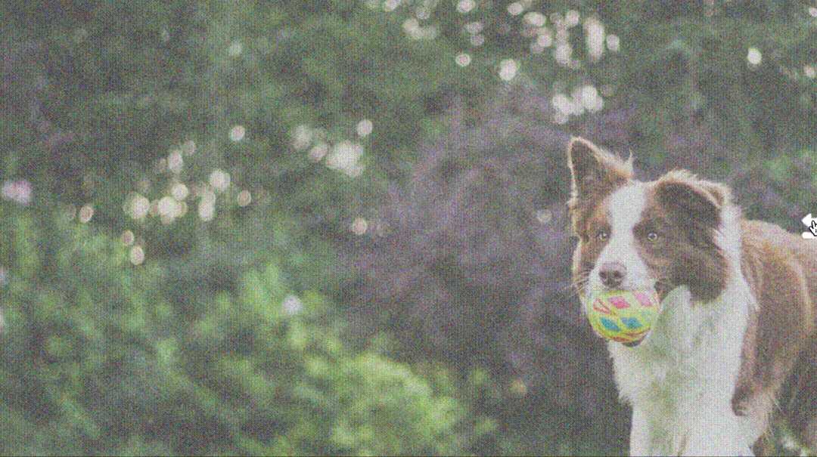
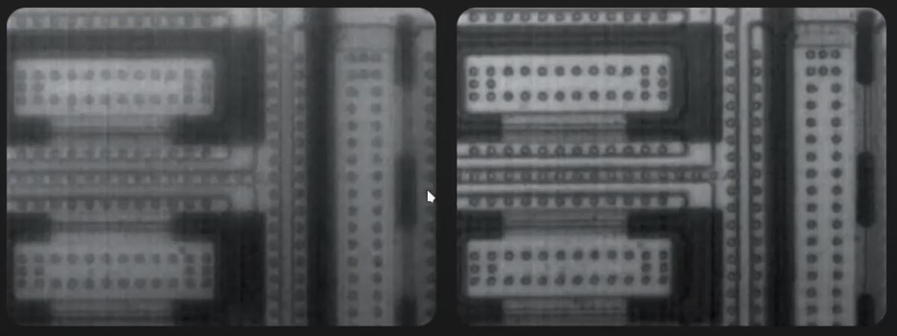
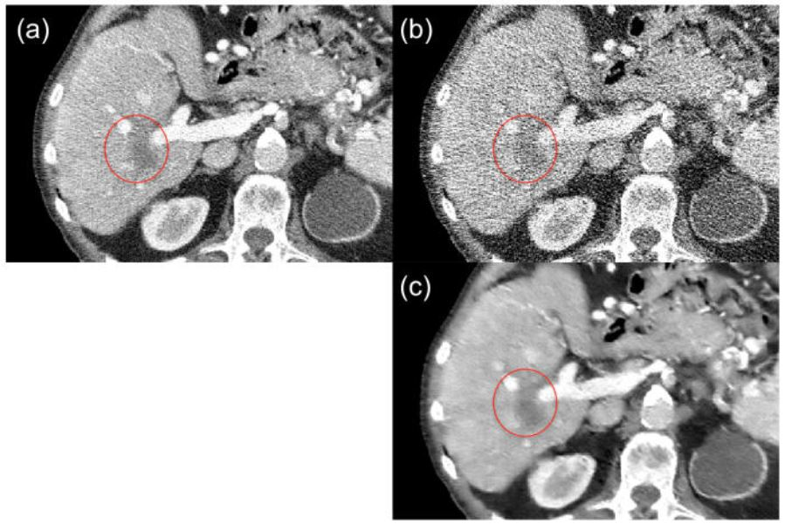
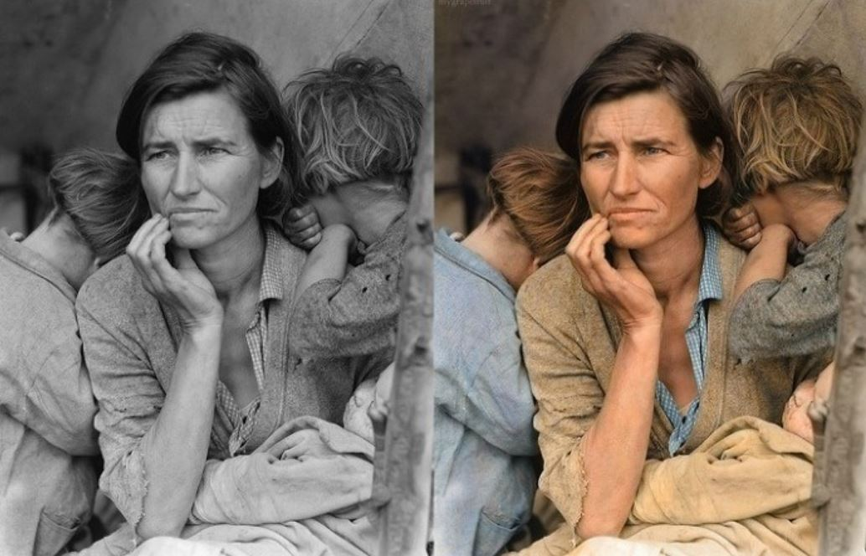
Applications
SR Applications (Image Restoration)

Slide 70
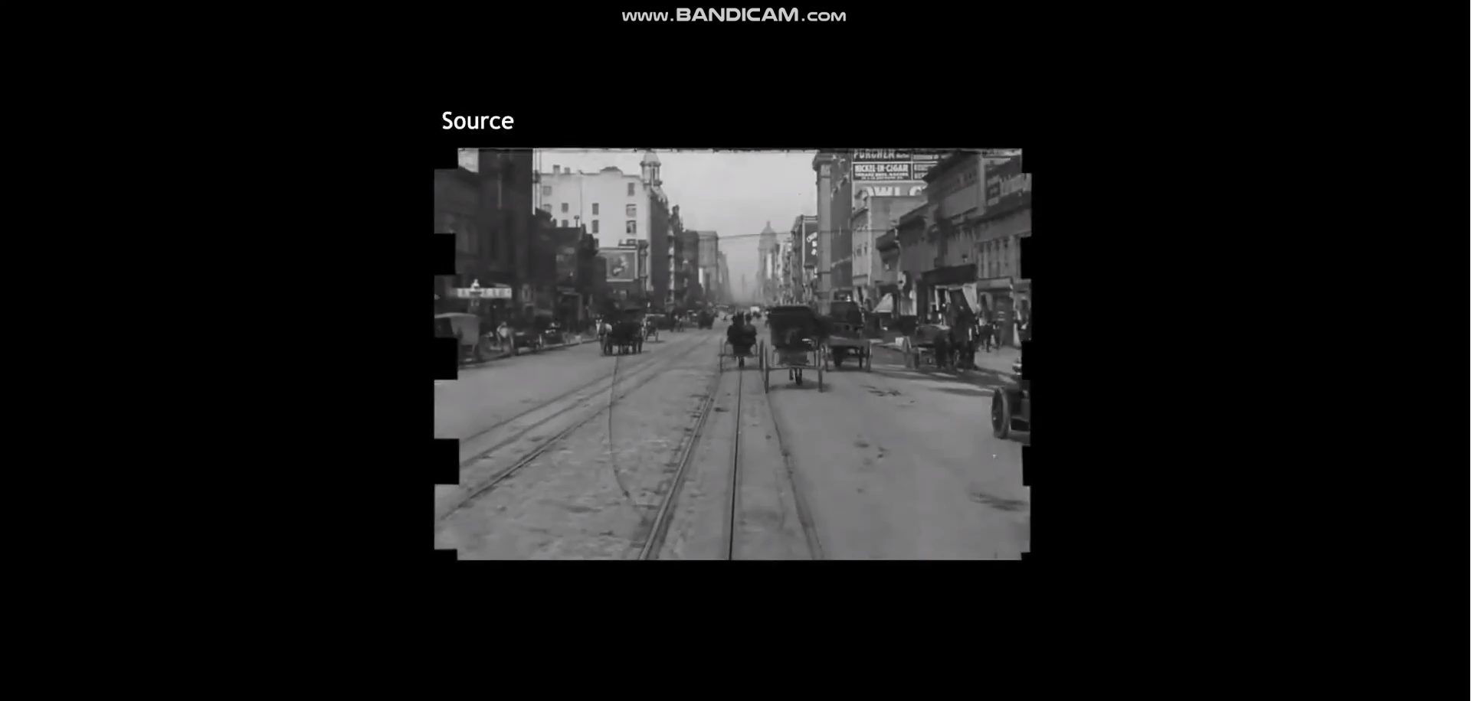
Applications
SR Applications (Video Restoration)

Slide 71
Conclusions
Ref.: [Proc. on IEEE 1998] Gradient-based learning applied to document recognition

Slide 72
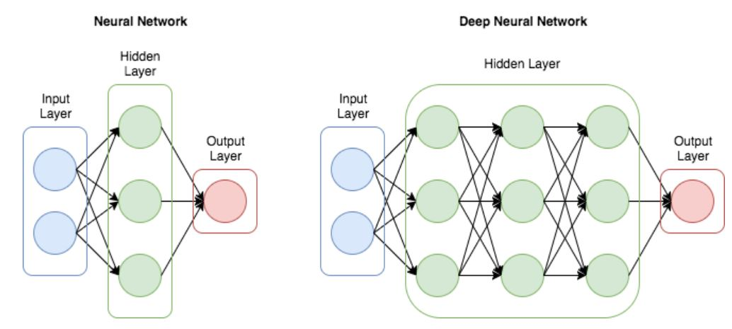
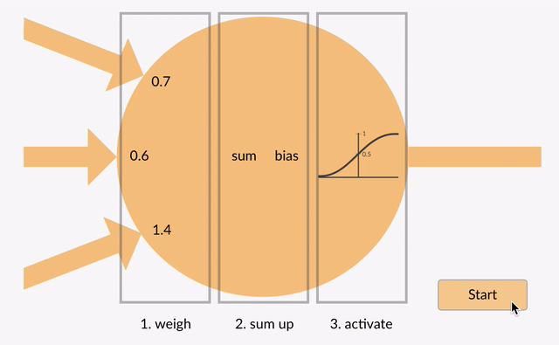
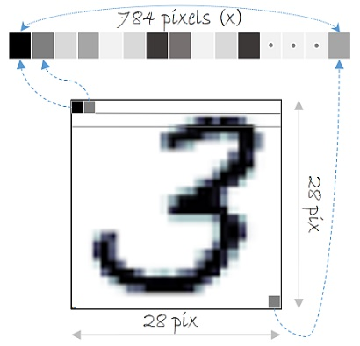
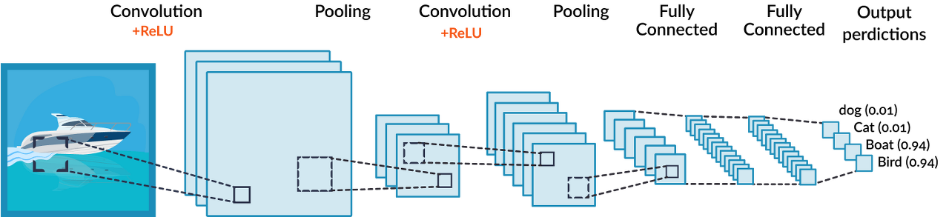



MLP vs CNN
Artificial Neural Network (ANN) → Deep Neural Network (DNN)
Convolution Neural Network (CNN)

Slide 73





References
The world’s top 5 conferences
(CVPR)
(NIPS)
(ICCV)
(ECCV)
(AAAI)
Ref) https://research.com/conference-rankings/computer-science?p=Q3-2021

Slide 74
Dongsan Jun (dsjun@dau.ac.kr)
Image Signal Processing Laboratory (www.donga-ispl.kr)
Dept. of Computer Engineering
Dong-A University, Busan, Rep. of Korea

